Slide 1
Intro to ML

Slide 2
input → model → output
Let’s show this with a simple example!

Slide 3


Collect inputs and outputs
input | → | output
70 m² | → | € 260.000
91 m² | → | € 330.000
102 m² | → | € 400.000
150 m² | → | € 448.000
120 m² | → | € ?
Historical data
New data

Slide 4
Train the model
model
output
€ 400.000
€ 300.000
€ 200.000
70m² 100m² 130m² input

Slide 5
Predict outcome for new point
model
output
€ 400.000
120 m² input

Slide 6
In this example, the outcome was predicted by drawing a line. In NLP the data is too complex to be modeled by a line.
Solution: we connect different smaller models to each other and let them together learn a difficult model
= DL

Slide 7
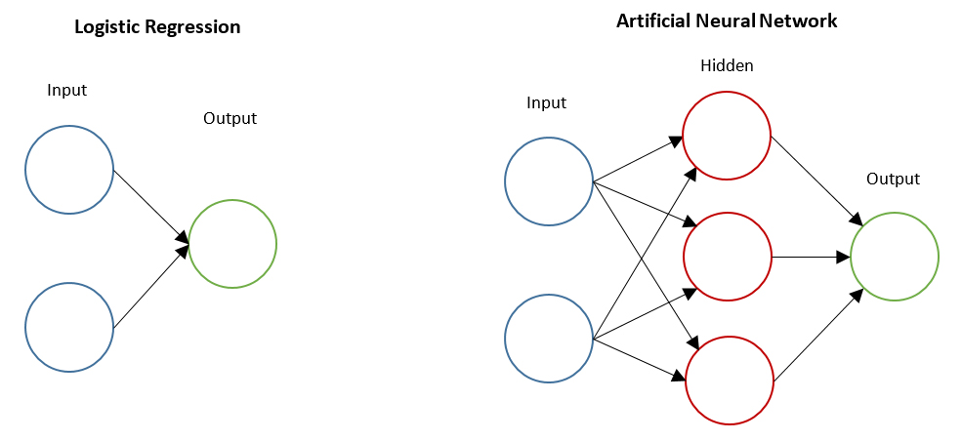
Simple Neural Network
Logistic regression
Neural network

Slide 8
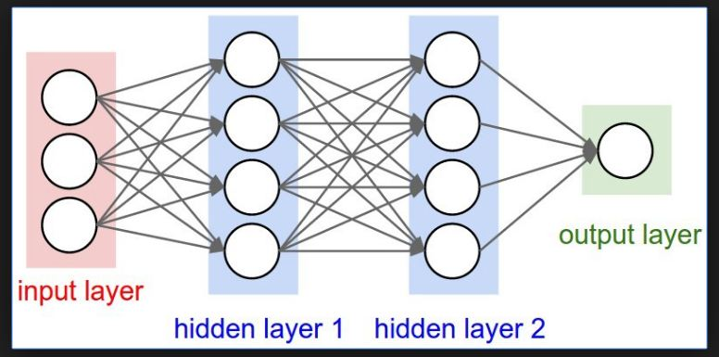
https://www.i2tutorials.com/hidden-layers-in-neural-networks/

Slide 9
Lexicon
1 circle = a neuron.
1 row of circles = a layer
We can have as many neurons as we want in one layer and we can have as many layers as we want in a network.
2 important layers:
Input layer: needs to have as much “circles” as there are features Output layer: needs to have as much “circles” as there are outputs to predict.

Slide 10
Things to keep in mind

Slide 11
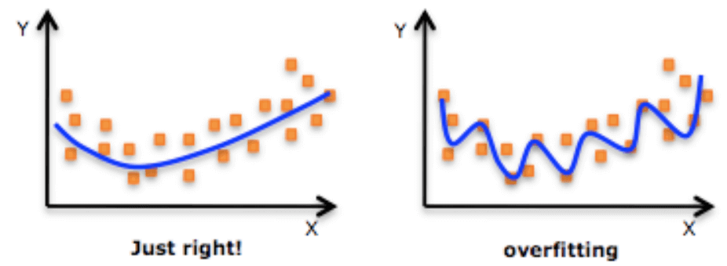
Make sure not to overfit
https://www.datarobot.com/wiki/overfitting/

Slide 12
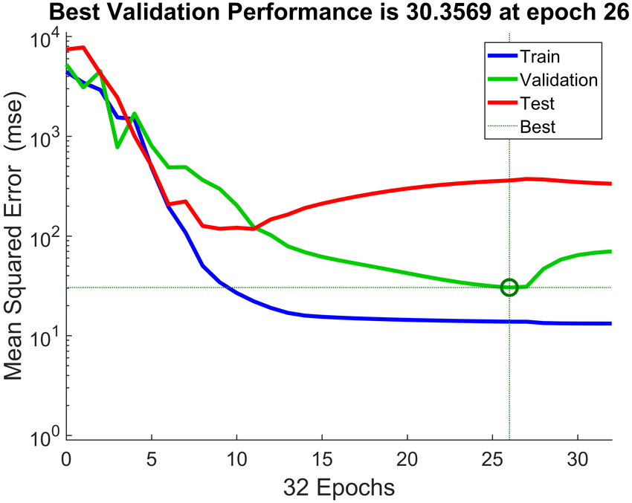
Make sure not to overfit
We need to split our data in a training dataset and a validation dataset.
Let the model train on the training dataset
Validate the performance of the model on the validation dataset
Once the performance of the validation starts to decrease again: stop

Slide 13
2. A NN needs a lot of examples to be able to differentiate

Slide 14


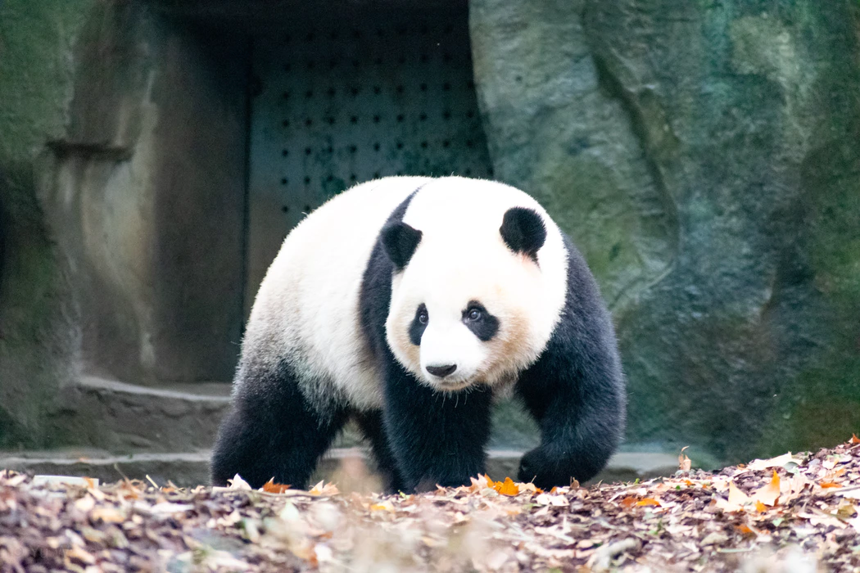
3. A NN cannot predict something it does not know about
Training data
Test data
?
?
?
?
?
?
?
?
?

Slide 15
How to use keras to implement networks
#Dependencies
from tensorflow.keras import layers, models, activations
from tensorflow.keras import models
from tensorflow.keras import activations
# Construct the Neural network
model = tf.keras.Sequential()
#define input layer
model.add(layers.Dense(4, input_shape=(3,)))
model.add(layers.Activation(activations.relu))
#define hidden layer
model.add(layers.Dense(4))
model.add(layers.Activation(activations.relu))
#model.add(layers.Dropout(0.5))
#define output layer
model.add(layers.Dense(1))
model.add(layers.Activation(activations.softmax))
#Train the network
model.compile(loss='categorical_crossentropy', optimizer='adam', metrics=['accuracy'])
print (model.summary())

Slide 16
Explanation
Sequential specifies to keras that we are creating model sequentially and the output of each layer we add is input to the next layer we specify.
model.add is used to add a layer to our neural network. We need to specify as an argument what type of layer we want.
The Dense is used to specify the fully connected layer. The arguments of Dense are output dimension which is 4 in the first case, input dimension which is 4 for input dimension and the activation function to be used which is relu in this case. The second layer is similar, we don’t need to specify input dimension as we have defined the model to be sequential so keras will automatically consider input dimension to be same as the output of last layer i.e 4. In the third layer(output layer) the output dimension is 1. Now as we have discussed earlier, the output layer takes different activation functions and for the case of multiclass classification, it is softmax.

